Slide 1
Core Java 8 and Development Tools
Lesson 03 : Language Fundamentals

Slide 2
Lesson Objectives
After completing this lesson, participants will be able to:
Understand Basic Java Language constructs like:
Keywords
Primitive Data Types
Operators
Variables
Literals
Write Java programs using control structures
Best Practices
Notes:
Lesson Outline:
3.1: Keywords
3.2: Primitive Data Types
3.3: Operators and Assignments
3.4: Variables and Literals
3.5: Flow Control: Java’s Control Statements
3.6: Best Practices

Slide 3
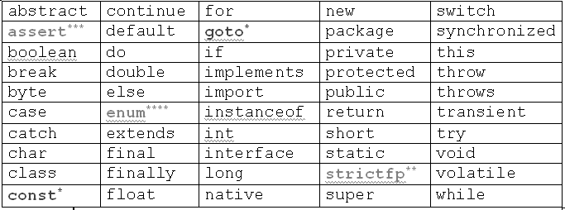
3.1 : Keywords Keywords in Java
Notes:
Keywords are reserved identifiers that are predefined in the language and cannot be used to denote other entities. E.g. class, boolean, abstract, do, try etc. Incorrect usage results in compilation errors.
In addition, three identifiers are reserved as predefined literals in the language: null, true and false.
The table above shows the keywords available in Java 5.

Slide 4
3.2: Primitive Data types Java Data types
Type
Size/Format
Description
byte
8-bit
Byte-length integer
short
16-bit
Short Integer
int
32-bit
Integer
long
64-bit
Long Integer
float
32-bit IEEE 754
Single precision floating point
double
64-bit IEE 754
Double precision floating point
char
16-bit
A single character
boolean
1-bit
True or False
Notes:
There are two data types available in Java:
Primitive Data Types.
Reference/Object Data Types :- is discussed later.
There are eight primitive data types supported by Java (see slide above). Primitive data types are predefined by the language and named by a key word.
The default character set used by Java language is Unicode character set and hence a character data type will consume two bytes of memory instead of a byte (a standard for ASCII character set). Unicode is a character coding system designed to support text written in diverse human languages.
This allows you to use characters in your Java programs from various alphabets such as Japanese, Greek, Russian, Hebrew, and so on. This feature supports a readymade support for internalization of java.
The default values for the various data types are as follows:
Integer : 0
Character : ‘\u0000’
Decimal : 0.0
Boolean : false
Object Reference: null
[Note: C or C++ data types pointer, struct, and union are not supported. Java does not have a typedef statement (as in C and C++).]

Slide 5
3.3 : Operators and Assignments Operators in Java
Operators can be divided into following groups:
Arithmetic
Bitwise
Relational
Logical
instanceof Operator
Notes:
Java provides a rich set of operators to manipulate variables. These are classified into several groups as shown above.

Slide 6
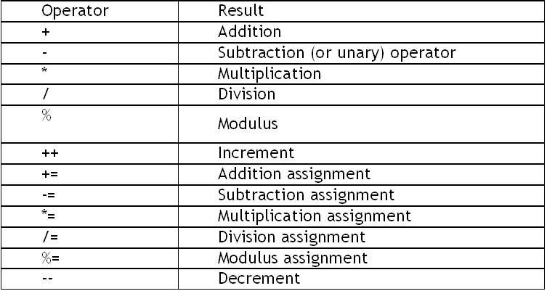
3.3 : Operators and Assignments Arithmetic Operators
Notes:
Arithmetic operators are summarized in the table above:
Integer division yields an integer quotient for example, the expression 7 / 4 evaluates to 1, and the expression 17 / 5 evaluates to 3. Any fractional part in integer division is simply discarded (i.e., truncated) no rounding occurs.
Java provides the remainder operator, %, which yields the remainder after division. The expression x % y yields the remainder after x is divided by y. Thus, 7 % 4 yields 3, and 17 % 5 yields 2. This operator is most commonly used with integer operands, but can also be used with other arithmetic types.
Parentheses are used to group terms in Java expressions in the same manner as in algebraic expressions. For example, to multiply a times the quantity b + c, we write a*(b+c).
If an expression contains nested parentheses, such as ((a+b)*c) the expression in the innermost set of parentheses (a + b in this case) is evaluated first.
Order of Precedence:
Multiplication, division and remainder operations are applied first. If an expression contains several such operations, the operators are applied from left to right. Multiplication, division and remainder operators have the same level of precedence.
Addition and subtraction operations are applied next. If an expression contains several such operations, the operators are applied from left to right. Addition and subtraction operators have the same level of precedence.

Slide 7
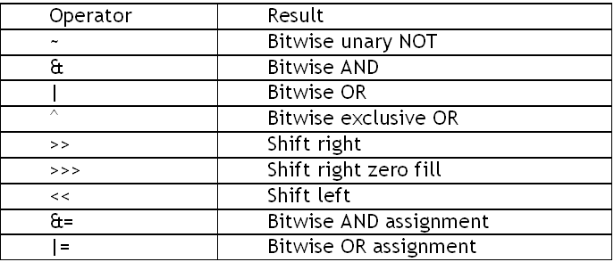
3.3 : Operators and Assignments Bitwise Operators
Apply upon int, long, short, char and byte data types:
Notes:
The Java programming language also provides operators that perform bitwise and bit shift operations on integral types. The operators discussed in this section are less commonly used.
The unary bitwise complement operator "~" inverts a bit pattern; it can be applied to any of the integral types, making every "0" a "1" and every "1" a "0". For example, a byte contains 8 bits; applying this operator to a value whose bit pattern is "00000000" would change its pattern to "11111111".
The signed left shift operator "<<" shifts a bit pattern to the left, and the signed right shift operator ">>" shifts a bit pattern to the right. The bit pattern is given by the left-hand operand, and the number of positions to shift by the right-hand operand. The unsigned right shift operator ">>>" shifts a zero into the leftmost position, while the leftmost position after ">>" depends on sign extension.
Bitwise & operator performs a bitwise AND operation.
Bitwise ^ operator performs a bitwise exclusive OR operation.
Bitwise | operator performs a bitwise inclusive OR operation.

Slide 8
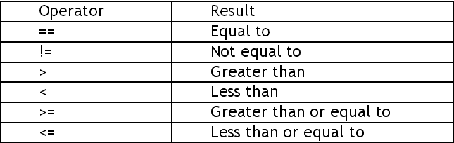
3.3 : Operators and Assignments Relational Operators
Determine the relationship that one operand has to another.
Ordering and equality.
Notes:
A condition is an expression that can be either true or false. For example, the condition "grade is greater than or equal to 60" determines whether a student passed a test. If the condition in an if statement is true, the body of the if statement executes. If the condition is false, the body does not execute.
Conditions in if statements can be formed by using the equality operators (== and !=) and relational operators (>, <, >= and <=). Both equality operators have the same level of precedence, which is lower than that of the relational operators. The equality operators associate from left to right. The relational operators all have the same level of precedence and also associate from left to right.

Slide 9
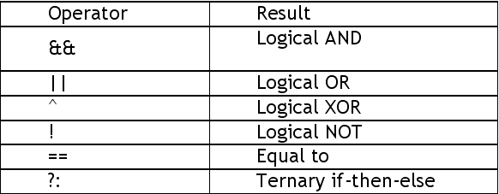
3.3 : Operators and Assignments Logical Operators
Notes:
Java provides logical operators to enable programmers to form more complex conditions by combining simple conditions. The logical operators are && (conditional AND), || (conditional OR), & (boolean logical AND), | (boolean logical inclusive OR), ^ (boolean logical exclusive OR) and ! (logical NOT).

Slide 10
3.4: Variables and Literals Variables
Variables are data placeholders.
Java is a strongly typed language, therefore every variable must have a declared type.
The variables can be of two types:
reference types: A variable of reference type provides a reference to an object.
primitive types: A variable of primitive type holds a primitive.
In addition to the data type, a Java variable also has a name or an identifier.
Stack
Primitive Variable
Instance
value
Reference Variable
Heap
reference
Reference Variable
null

Slide 11
3.4: Variables and Literals Types of Variables
Variable is basic storage in a Java program
Three types of variables:
Instance variables
Instantiated for every object of the class
Static variables
Class Variables
Not instantiated for every object of the class
Local variables
Declared in methods and blocks
Notes:
Instance variables: These are members of a class and are instantiated for every object of the class. The values of these variables at any instant constitute the state of the object.
Static variables: These are also members of a class, but these are not instantiated for any object of the class and therefore belong only to the class. We shall be covering the static modifier in later section.
Local variables: These are declared in methods and in blocks. They are instantiated for every invocation of the method or block. In Java, local variables must be declared before they are used.
Life-cycle of the variable is controlled by the scope in which those are defined.
Refer the example on the subsequent slide.

Slide 12
3.4: Variables and Literals Types of Variables
public class Box {
private double dblWidth;
private double dblHeight;
private double dblDepth;
private static int boxid;
public double calcVolume() {
double dblTemp;
dblTemp = dblWidth * dblHeight * dblDepth;
return dblTemp;
}
}
Instance Variable
Static Variable
Local Variable
Notes:
Add the notes here.

Slide 13
3.4: Variables and Literals Literals
Literals represents value to be assigned for variable.
Java has three types of literals:
Primitive type literals
String literals
null literal
Primitive literals are further divided into four subtypes:
Integer
Floating point
Character
Boolean
For better readability of large sized values, Java 7 allows to include ‘_’ in integer literals.

Slide 14
3.5: Flow Control: Java’s Control Statements Control Statements
Use control flow statements to:
Conditionally execute statements
Repeatedly execute a block of statements
Change the normal, sequential flow of control
Categorized into two types:
Selection Statements
Iteration Statements
Notes:
Java being a programming language, offers a number of programming constructs for decision making and looping.

Slide 15
3.5: Flow Control: Java’s Control Statements Selection Statements
Allows programs to choose between alternate actions on execution.
“if” used for conditional branch:
“switch” used as an alternative to multiple “if’s”:
if (condition) statement1;
else statement2;
Expression can be
of String type!
switch(expression){
case value1: //statement sequence
break;
case value2: //statement sequence
break; …
default: //default statement sequence
}
Notes:
If Statement:
The if statement is Java’s conditional branch statement. It can be used to route program execution through two different paths.
Each statement may be a single statement or a compound statement enclosed in curly braces. The condition is any expression that returns a boolean value. The else clause is optional.
The if works like this: If the condition is true, then statement1 is executed. Otherwise, statement2 (if it exists) is executed. In no case will both statements be executed. For example, consider the following:
int a, b;
if(a < b) a = 0;
else b = 0;

Slide 16
3.5: Flow Control: Java’s Control Statements switch case : an example
class SampleSwitch {
public static void main(String args[]) {
for(int i=0; i<=4; i++)
switch(i) {
case 0:
System.out.println("i is zero."); break;
case 1:
System.out.println("i is one."); break;
case 2:
System.out.println("i is two."); break;
case 3:
System.out.println("i is three."); break;
default:
System.out.println("i is greater than 3.");
}
}}
Output:
i is zero.
i is one.
i is two.
i is three.
i is greater than 3.
Notes:
Switch – Case:
The switch statement is Java’s multi-way branch statement. It provides an easy way to dispatch execution to different parts of your code based on the value of an expression.
The switch-expression must evaluate to any of the following type:
byte
short
char
int
enum
String.
As such, it often provides a better alternative than a large series of if-else-if statements.

Slide 17
3.5: Flow Control: Java’s Control Statements Iteration Statements
Allow a block of statements to execute repeatedly
While Loop: Enters the loop if the condition is true
Do – While Loop: Loop executes at least once even if the condition is false
while (condition)
{ //body of loop
}
do
{ //body of the loop
} while (condition)
Notes:
while statement:
The body of the loop is executed as long as the conditional expression is true. When condition becomes false, control passes to the next line of code immediately following the loop. Example:
Output: 5 4 3 2 1
The while loop evaluates its conditional expression at the top of the loop. Hence, if the condition is false to begin with, the body of the loop will not execute even once.
do – while loop:
This construct executes the body of a while loop at least once, even if the conditional expression is false to begin with. The termination expression is tested at the end of the loop rather than at the beginning.
class Samplewhile {
public static void main(String args[]) {
int n = 5;
while(n > 0) {
System.out.print(n+”\t”);
n--;
} } }

Slide 18
3.5: Flow Control: Java’s Control Statements Iteration Statements
For Loop:
Example
for( initialization ; condition ; iteration)
{ //body of the loop }
// Demonstrate the for loop.
class SampleFor {
public static void main(String args[]) {
int number;
for(number =5; number >0; n--)
System.out.print(number +”\t”);
}
}
Output: 5 4 3 2 1
Notes:
for loop:
When the for loop first starts, the initialization portion of the loop is executed. Generally, this is an expression that sets the value of the loop control variable, which acts as a counter that controls the loop. The initialization expression is only executed once. Next, condition is evaluated. It usually tests the loop control variable against a target value. If this expression is true, then the body of the loop is executed, else the loop terminates. Next, the incremental portion of the loop is executed. This is usually an expression that increments or decrements the loop control variable. The loop then iterates, first evaluating the conditional expression, then executing the body of the loop, and then executing the iteration expression with each pass. This process repeats until the controlling expression is false.

Slide 19
3.5: Control Structures Demo
Data types in Java
Switch Statement using String as expression
Notes:
Add the notes here.

Slide 20
3.6: Best Practices Best practices: Iteration Statements
Always use an int data type as the loop index variable whenever possible
Use for-each liberally
Switch case statement
Terminating conditions should be against 0
Loop invariant code motion
E.g If you call length() in a tight loop, there can be a performance hit.
Notes:
Always use an int data type as the loop index variable whenever possible.
It is efficient when compared to using byte or short data types. This is because when we use byte or short data type as the loop index variable they involve implicit type cast to int data type.
Use for-each liberally.
The for-each loop is used with both collections and arrays. It is intended to simplify the most common form of iteration, where the iterator or index is used solely for iteration, and not for any other kind of operation, such as removing or editing an item in the collection or array.
When there is a choice, the for-each loop should be preferred over the for loop, since it increases legibility.
Switch Case statement.
One peculiar fact about switch statements is that code consisting of case with consecutive constants like 0,1,2 are faster than with case with constants like 2, 6, 7, 14, etc. This is because in the former switching between options requires less offset and it takes only 16 bytes. But in the later the offset is higher and it might take 32 or more bytes.

Slide 21
3.6: Best Practices Best practices: Iteration Statements
Notes Pages
Notes:
Terminating conditions should be against 0. For example:
for(int i=0;i<length;i++){ …… } for(int i=length-1;i>=0;i--){ …… }
The later one is 30% faster than the former. Just you are comparing with constant instead of accessing a.length everytime.
Loop invariant code motion.
If in a loop a expression is evaluated in every iteration the performance may be slow. This is called "Loop invariant code motion". Instead evaluate the expression outside the loop.
length() is a method in String used to obtain the number of characters currently in the string. If you call length()in a tight loop, there can be a performance hit.
Example:
for(int i =0;i <s.length(); i++) { //AVOID
…
}
// precomputed length
int len = s.length();
for(int i =0; i < len; i++) {
….
}

Slide 22
Summary
In this lesson you have learnt:
Keywords
Primitive Data Types
Operators and Assignments
Variables and Literals
Flow Control: Java’s Control Statements
Best Practices

Slide 23
Review Question
Question 1: Java considers variable number and NuMbEr to be identical.
True/False
Question 2: The do...while statement tests the loop-continuation condition __________ it executes executing the loop's body; hence, the body executes at least once.
Option1: before
Option2: after

